Slide 1
GROUP 5C
Backend Development • October 2026
Retail Inventory & Expiry Management API
An Express.js REST API providing real-time stock visibility, automated expiration tracking, and flexible query filtering.
PROJECT ENGINEERING TEAM
David Oladele
Musibau BOLAJI (Adigson)
Precious Chisom
Jamila Umar Adam
Okwara Godfrey
Ezekiel Micheal Danlami
Noah Fater Kusa
Yahaya Sheidu

Slide 2
01 / Context & Challenge
Retail Stock Blind Spots & Operational Friction
Unnoticed Product Expirations
Stockout Bottlenecks
Unstructured Tracking
Perishable items expire undetected on retail shelves, causing heavy financial loss and safety non-compliance.
Manual inventory tracking fails to highlight low-stock thresholds quickly, leading to unfulfilled orders.
Spreadsheets and paper logs cause human error, inconsistent SKUs, and delayed store decisions.
The Solution: An lightweight, automated Express REST API delivering fast stock visibility, schema validation, and targeted expiration alerts.

Slide 3




02 / Goals
Core Objectives & API Scope
Full CRUD Operations
Search & Filtering
Threshold Alerts
Schema Integrity
Standardized HTTP methods to create, read, update, and delete product records.
Instant query processing by category tags and keyword pattern matching.
Dynamic filtering for low stock levels and items approaching expiration date.
Input middleware ensuring unique SKUs, valid dates, and required product fields.
Primary Goal: Provide a clean, developer-friendly backend foundation to keep retail product records accurate and actionable.

Slide 4





03 / Technology Stack
Backend Ecosystem & Developer Tooling
Node.js
Express.js
JavaScript ES6+
In-Memory Array
Jest & Postman
Asynchronous runtime execution.
REST API routing & middleware.
Modern language features.
Fast local dataset storage.
33 Unit tests & API runner.
Version Control & Collaboration: Git / GitHub (PR Verification Flow)
Status: Production Ready Core

Slide 5
04 / Architecture
Request Lifecycle & Flow Pipeline
STEP 01
STEP 02
STEP 03
STEP 04
STEP 05
Client Request
Express Server
Validation
Product Store
JSON Response
Postman / HTTP Client
CORS + JSON Parsing
SKU & Schema Check
In-Memory Array Ops
200 OK / 404 Error
Error Handling Integration: Unhandled routes trigger a structured 404 JSON handler. Runtime operational errors pass through centralized error middleware.

Slide 6
05 / Features
Core API Capabilities & Services
Product Catalog CRUD
Multi-Query Filtering
Create products with unique IDs and auto-generated timestamps. Full update and delete capabilities.
Filter instantly by category (e.g. Dairy, Bakery) and partial keyword text search on product names.
Low-Stock Threshold Alerts
Expiry Window Alerts
Queries stock levels below user-defined parameter thresholds (e.g. ?threshold=10) for restocking.
Detects items expiring within a configurable day window (e.g. ?days=7) to prevent inventory rot.
All responses conform to standardized RESTful JSON formats with explicit status codes.

Slide 7
06 / Codebase
Project Directory & Modular Architecture
retail-inventory-api/
src/server.js
├── src/
Application entry point; mounts CORS, body parsers, and global error handlers.
├── data/ → productStore.js
├── middleware/ → validateProduct.js, errorHandler.js
src/routes/productRoutes.js
├── routes/ → productRoutes.js
Declares endpoints for CRUD operations, search filters, and alert triggers.
└── server.js
├── tests/ → 33 Jest Unit Tests
├── postman/ → API Collection JSON
├── package.json
src/middleware/
└── README.md
Validates body parameters, SKU uniqueness, date formats, and centralizes errors.
Strict Separation of Concerns (SoC) ensures easy maintenance and smooth unit test isolation.

Slide 8
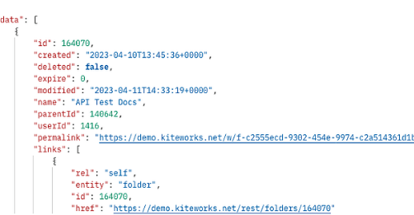
07 / Specifications
API Endpoints & Postman Execution
Postman API Request & Response View
Method | Endpoint Route | Function | Status
 | /health | Service status check | 200 OK
 | /api/products | List & query products | 200 OK
 | /api/products | Create product record | 201 Created
 | /api/products/:id | Update stock or details | 200 OK
 | /api/products/:id | Remove product item | 200 / 204
 | /api/products/low-stock | Alert query filter | 200 OK
GET
GET
POST
PUT
DELETE
GET
Postman Collection Execution: Verified live endpoint responses and JSON payloads.
Latency: ~40–130ms

Slide 9
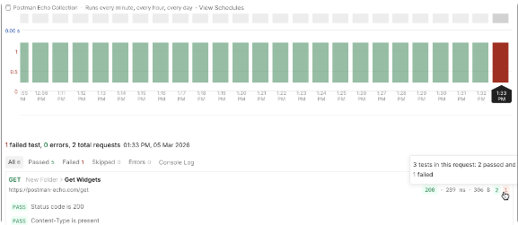
08 / Verification
Quality Assurance & Postman Test Runner
Postman Collection Test Runner Results
33
Automated Tests Passed
100% test pass rate in Postman Runner
SKU Uniqueness & Schema Checks
Validates duplicate SKU rejection and parameter type constraints.
404 & Error Middleware Handling
Catches invalid routes and standardizes error responses.
Automated test suite verified green build across all 33 endpoint assertions in Postman.

Slide 10
09 / Future Outlook
Current Boundaries & Production Roadmap
Current Boundaries
Production Roadmap
• Volatile Storage: Data resets on server restart.
• Database Integration: MongoDB / PostgreSQL persistent data.
• No Authentication: Unrestricted route access.
• No Frontend UI: API interface only via Postman.
• Security & RBAC: JWT authentication & role authorization.
• Cloud Deployment: Docker containerization & Render hosting.
DEMO PROTOTYPE SCOPE
FUTURE EXPANSION TARGET
Next Engineering Milestone: Implement ORM layer (Prisma or Mongoose) to transition from in-memory array to persistent database storage.

Slide 11
PROJECT SHOWCASE COMPLETE
Thank You!
Retail Inventory and Expiry Management API — Built by Group 5C for Backend Development.
GitHub Repository Ready
Postman Collection Included
Questions & Comments?

Slide 12


Image Sources
https://us1.discourse-cdn.com/getpostman/optimized/2X/d/d722505d83665b9bc9cce607156b3725a11b0668_2_690x313.png
Source: community.postman.com
https://assets.postman.com/postman-docs/v12/viewing-scheduled-collection-tests-v12-01.png
Source: learning.postman.com

